Slide 1
Marketing Research Project
On Starbucks
Presenter: Anni Liu

Slide 2
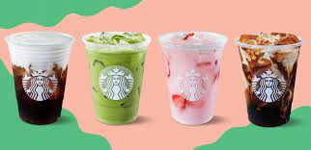
Part 1: Table of Contents

Slide 3
Table of Contents
Problem Definition
Research Purpose
Research Design
Data Analysis & Results
Conclusions & Recommendations

Slide 4

Part 2: Problem Definition

Slide 5
A. Background and Context
Starbucks: Multinational coffee company that produces high-quality coffee and positively impacts customers, employees, and the environment.
Goods include coffee, latte, refresher cold drinks, and bakeries.
The Starbucks App: Earn Stars with each purchase.The number of Stars earned depends on the purchase amount (earning 1 star per $1 spent at the store) and any promotions (bonus offer).
Free rewards offered: customized drink with no constraints (200 stars), hot coffee with no constraints (150 stars), bakery items (100 stars), merchandises like a Tumbler (400 stars), customization option like adding a shot (25 stars)

Slide 6

B. Underlying Problem Symptoms
Symptoms:
Starbucks' increased coffee prices have negatively impacted its market performance and competitiveness.
Starbucks blamed on inflation for increasing the price: inflation did have a negative impact on working or lower class families whose household incomes are below $50,000.
Customers will eventually look for a cheaper option when buying a coffee.
Defined Underlying Problem
Basic discovery-oriented research was conducted to uncover the problem by searching online articles and forums.

Slide 7
C. Major Competitors and Overall Market
Coffee market leaders (The Mordor Intelligence): The Kraft Heinz Company, The Coca-Cola company, and Nestle
→ They produce grounded coffee beans, Nespresso coffee pods that allow consumers to make coffee at home.
International market performance: Starbucks has closed more than 2000 stores in China due to pandemic and aggressive coffee brand competition in China (NPR 2020 data).
Conclusion
Unsatisfied demand/need: customers seeking for affordable ways to get coffee

Slide 8
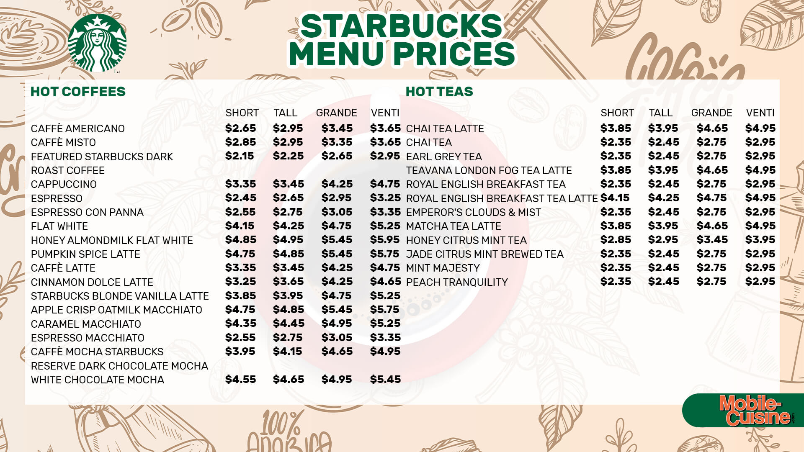
Part 3: Research Purpose

Slide 9
Objective of Research Purpose/ Marketing Strategy
Objective of Research
To test if increasing prices would make Starbucks less competitive in the market.
Marketing Strategy
The proposed marketing strategy is to offer more promotions/discounts to indirectly decrease coffee prices.
Rationales:
Competitors were increasing price during the pandemic
Supply Chain during the pandemic was the hidden reason of increasing price
There are many ways to play around the reward system such as making customers redeem free drinks with fewer stars, and making them be able to collect the stars quicker.

Slide 10
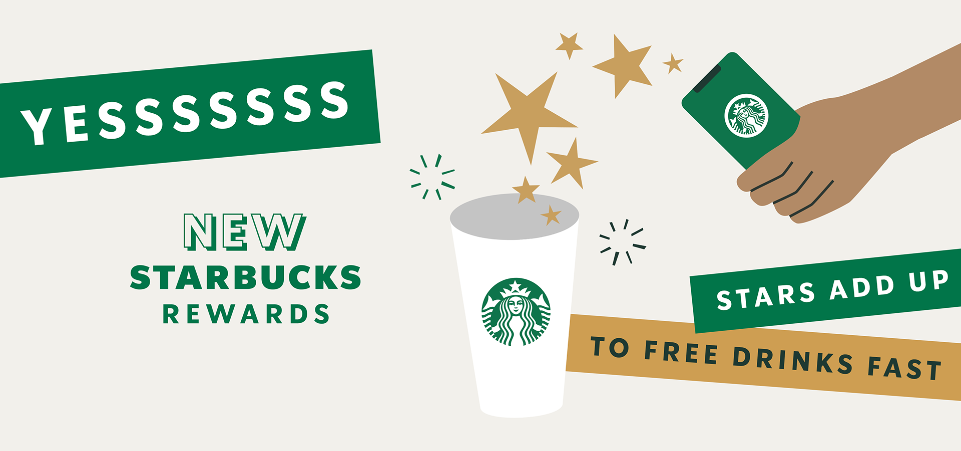
Part 4: Research Design

Slide 11
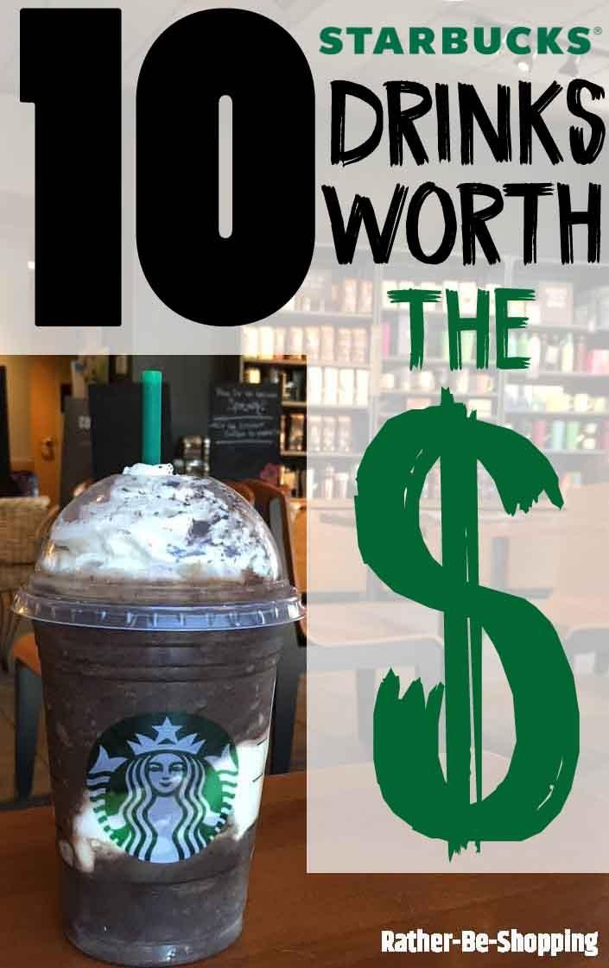
Proposed Marketing Strategy
The proposed marketing strategy is to offer more promotions/discounts to indirectly decrease coffee prices.
The implementation plan includes offering more loyalty rewards and partnering with local businesses to offer discounts.

Slide 12
Type of Data Collected for Strategy-Oriented Problem
Creating Survey Questions: Primary, Quantitative, and Descriptive
Rationales:
Knowing consumers’ attitudes based on 3 components: cognition, behavior, and affection.
Cognitive questions: rate the affordability of Starbucks products, how familiar you are with Starbucks reward program, etc.
Affective questions: how satisfied are you with the reward program, please rank the following brands by preference etc.
Behavioral questions: how often do you visit Starbucks, is your frequency of visiting the store going to change if there is a bonus offer, etc.

Slide 13
A.Type of Data Collected for Strategy-Oriented Problem
Rationales continued:
We can also know the predictors of consumers’ attitudes by asking them demographic questions in the survey
Demographic question: average annual income
We can measure the attitude in the survey by creating categorical, ordinal, and numerical questions.
Categorical questions: rank the ways of getting a cup of coffee , etc.
Ordinal questions: how would you rate Starbucks coffee in terms of price, etc.
Numerical questions: on a scale of 1-7, how would you rate Starbucks reward program, etc.

Slide 14
B/C: Contact Method/Sampling Plan
Contact Method:
We distributed the questionnaire through:
GroupMe
IMessage
Instagram
Asking people in the Starbucks at the Yard and random people on the street to fill out questionnaire
Sampling Plan:
Population of interest: Coffee drinkers who have a consideration set when making a purchase decision (not necessarily loyal to Starbucks); somewhat familiar with Starbucks reward program and have drinked coffee from Starbucks before.
Sampling method: simple random sample (asking people on the street), convenience sample (asking friends/classmates to fill out our survey), cluster sampling (asking customers in Starbucks at the Yard).

Slide 15
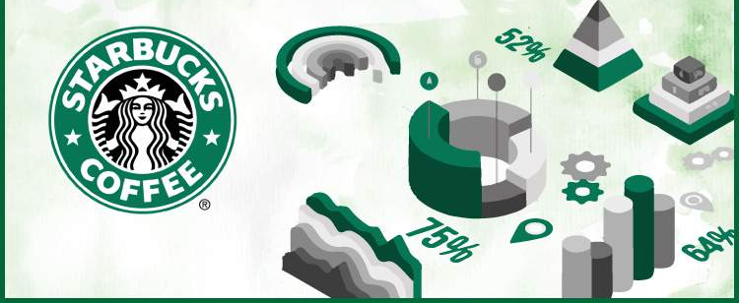
Part 5: Data Analysis & Results

Slide 16
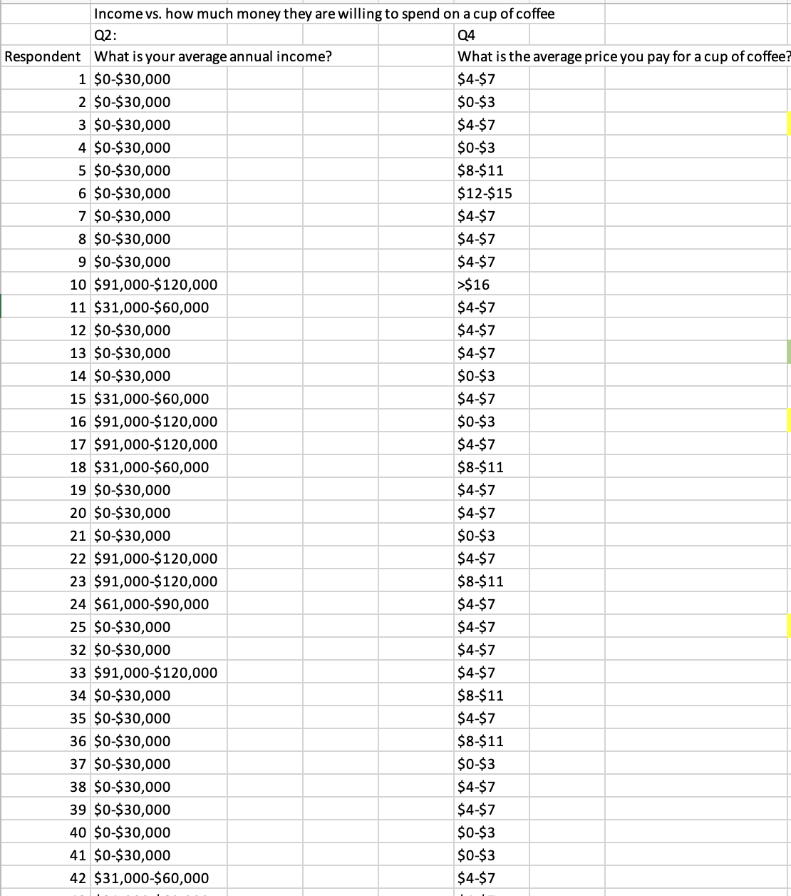
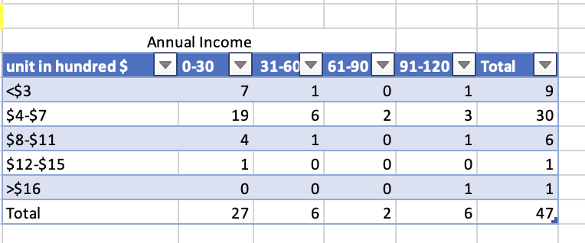
Description of Our Data: HT 1
Questions : What is your average annual income? What is the average price you pay for a cup of coffee?

Slide 17
B. Hypothesis Test and Statistical Method
Hypothesis Test 1: Annual Income vs. Average money people pay per cup
Ho: There is no relationship between annual income and average price people pay per cup
Ha: There is a relationship between annual income and average price people pay per cup
Statistical Method: Chi-Square
Categorical variables
Compare actual result with expected result
Relationship between two categorical variables

Slide 18
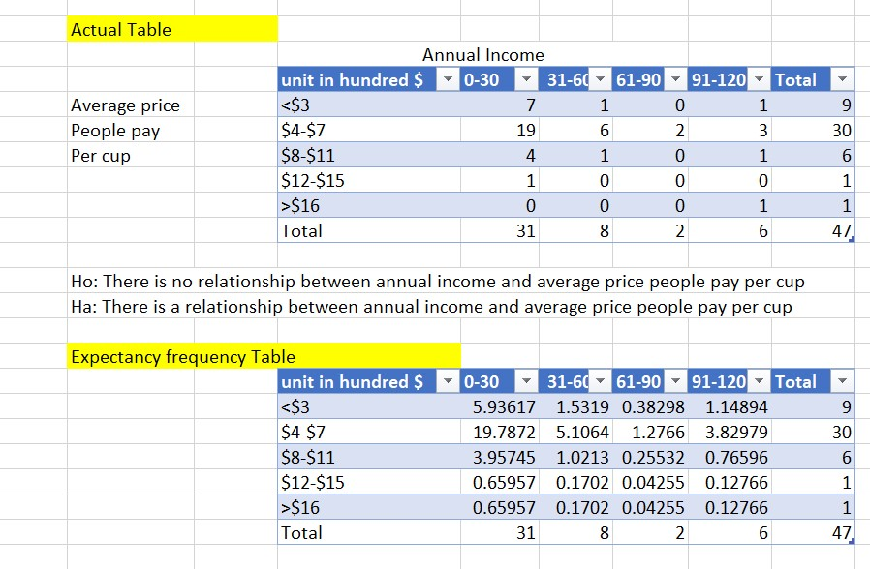
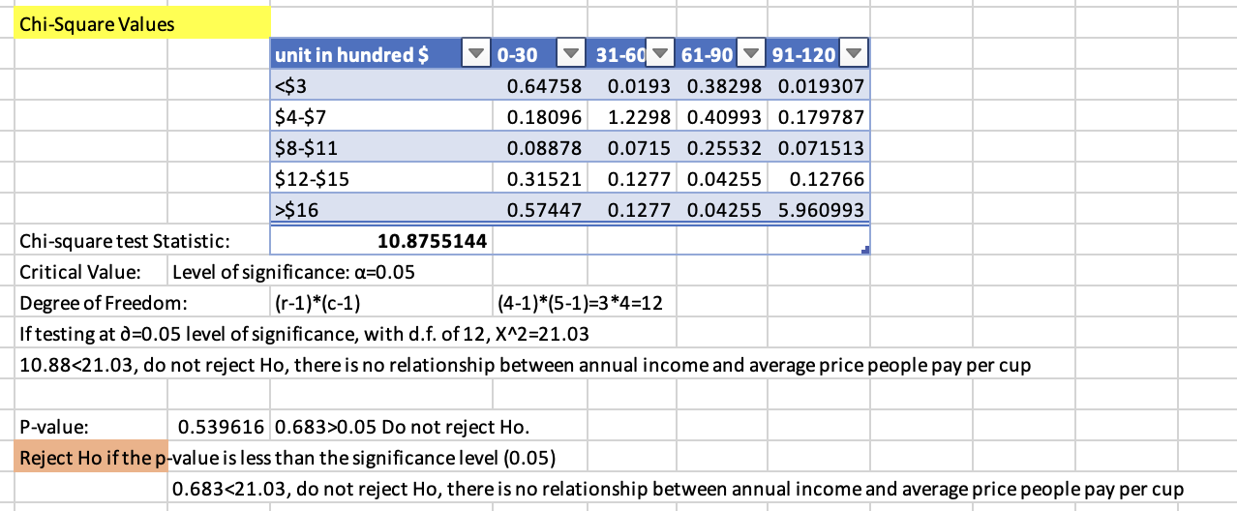
C. Results of Hypothesis Tests at Significance level =0.05
Do not reject Ho
There is no relationship between annual income and average money people pay per cup of coffee

Slide 19
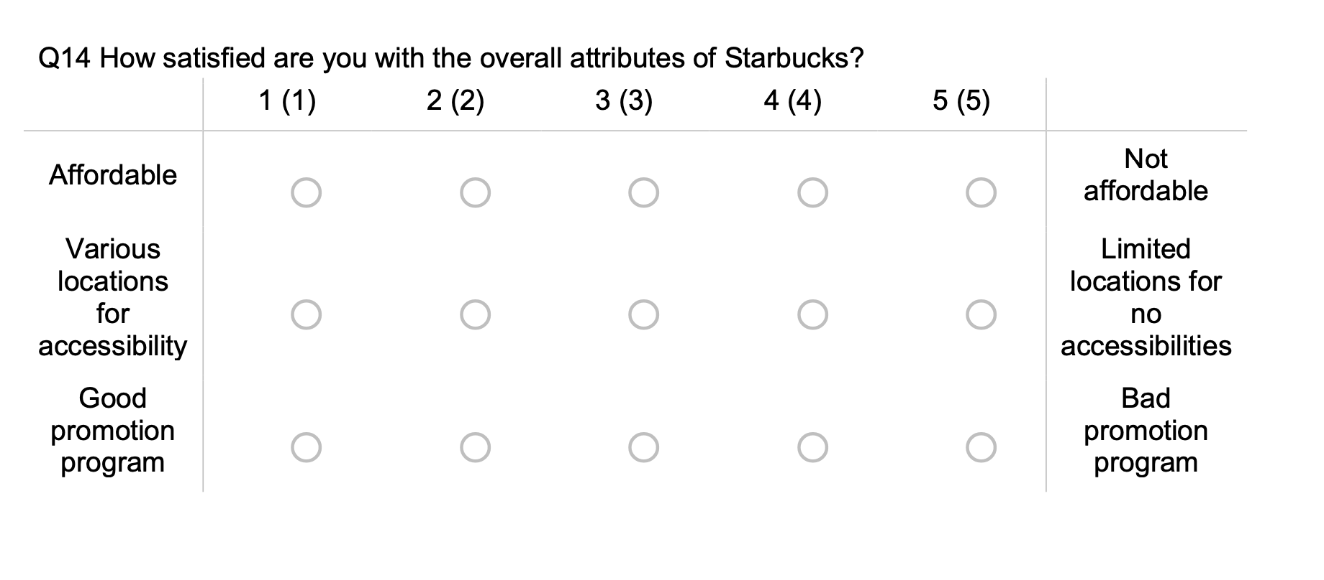
Description of Our Data: HT2

Slide 20
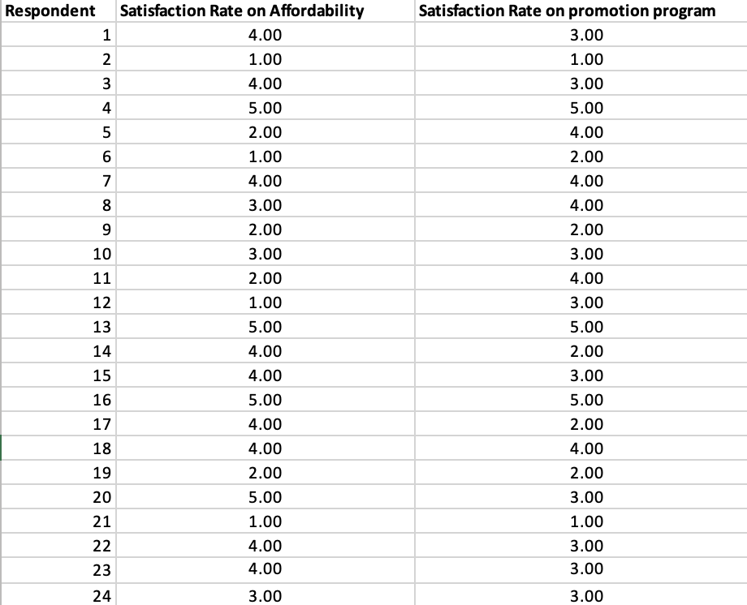
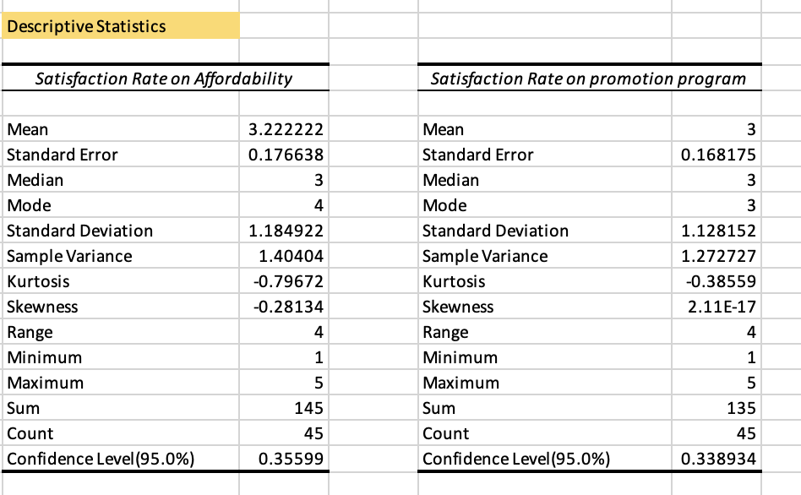
Description of Our Data: HT2

Slide 21
B. Hypothesis Test and Statistical Method
Hypothesis Test 2: Satisfaction Rate on Affordability (μ1)vs. Satisfaction Rate on Promote Program (μ2)
Ho:There is no difference between consumers' satisfaction rate on affordability of coffee and their rate on promotion program (μ1=μ2)
Ha：There is difference between consumers' satisfaction rate on affordability of coffee and their rate on promotion program (μ1≠μ2)
Statistical Method: Two Sample t-test assume equal variance
Two independent groups
Determine whether two population means are equal
Numerical

Slide 22
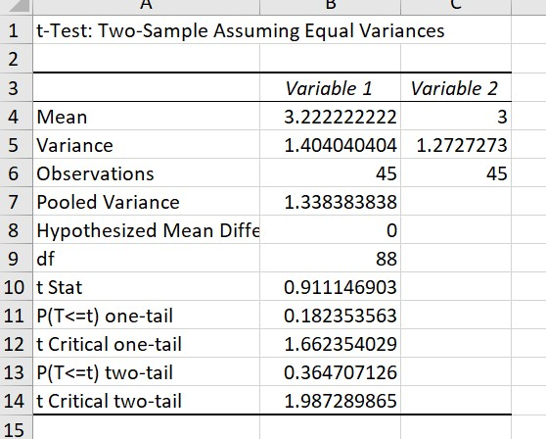
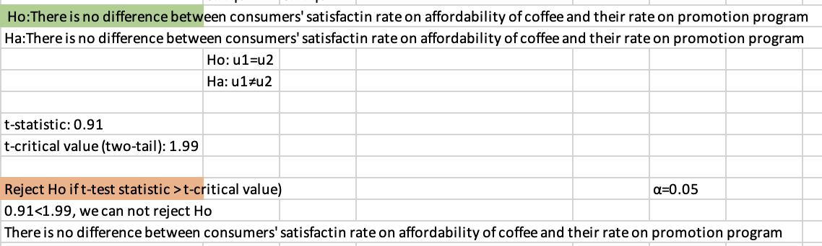
C. Results of Hypothesis Tests at Significance level =0.05
Hypothesis Test 2

Slide 23
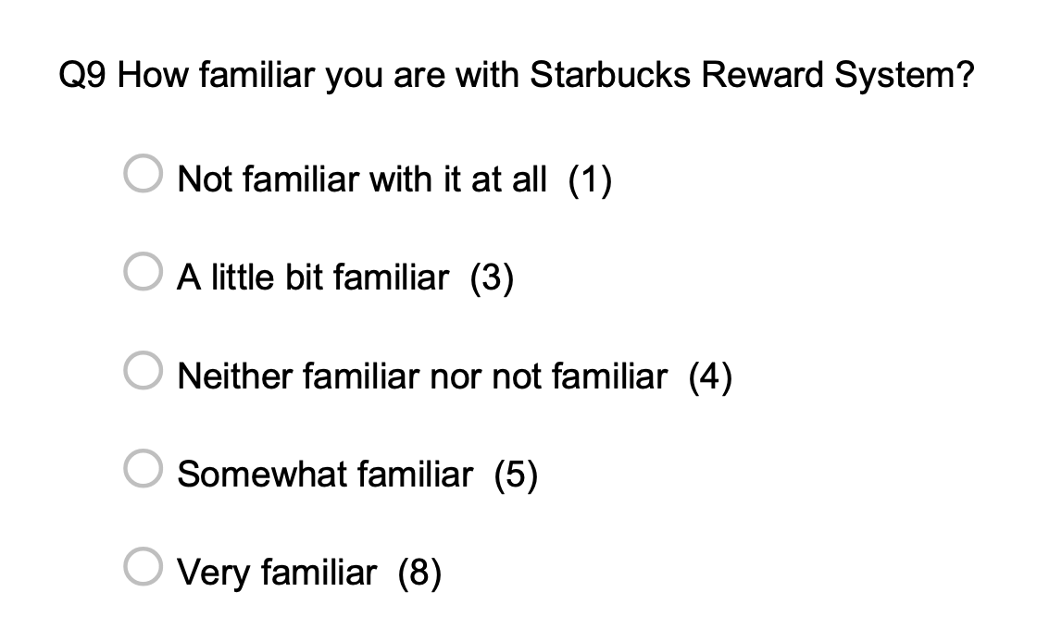
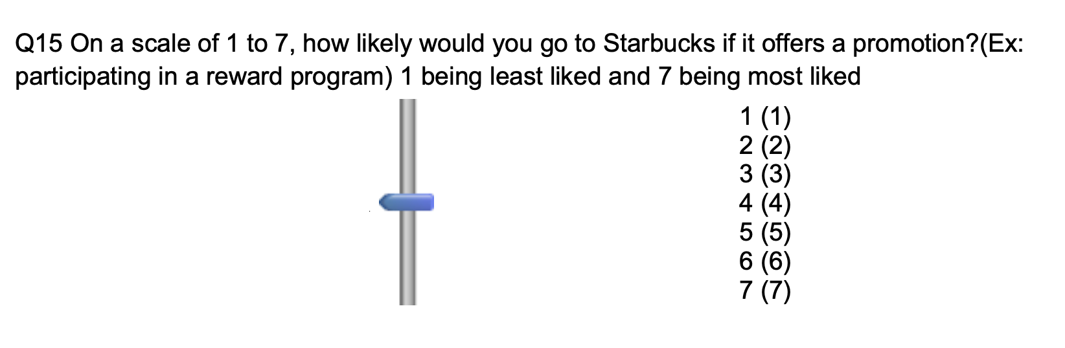
Description of Our Data: HT3
4

Slide 24
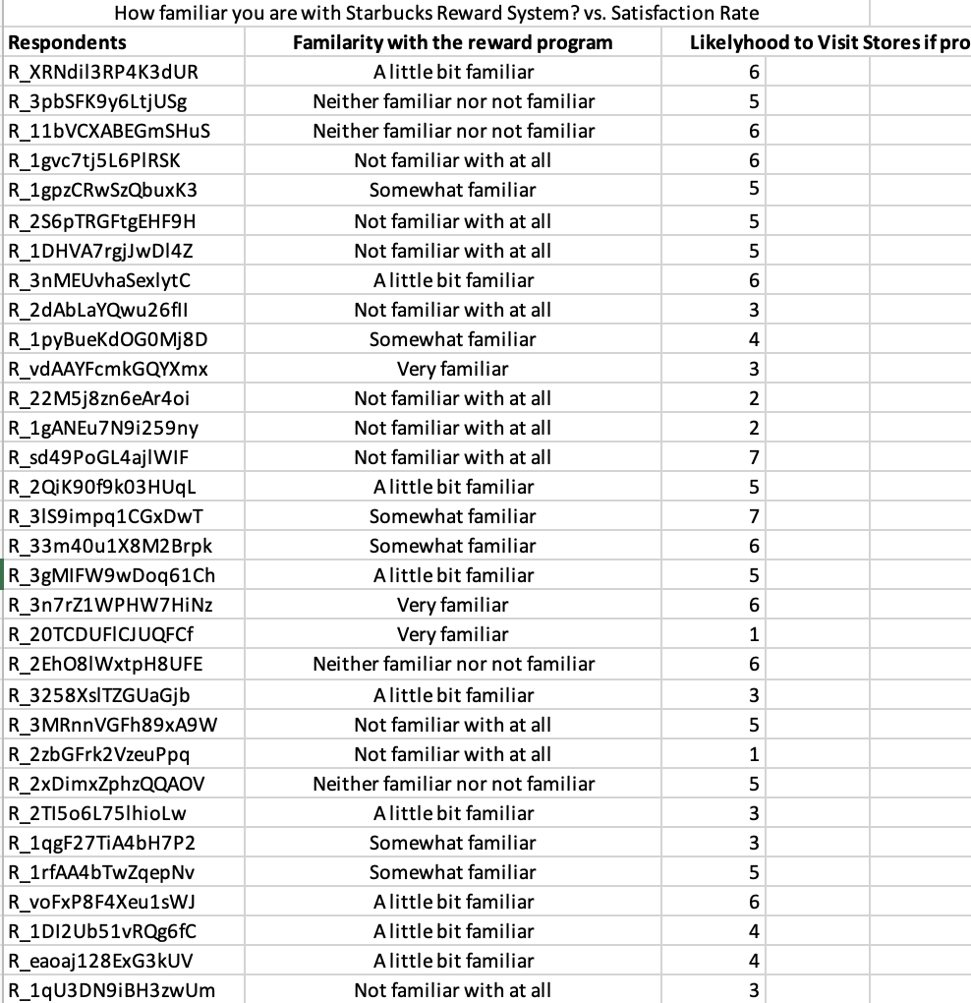
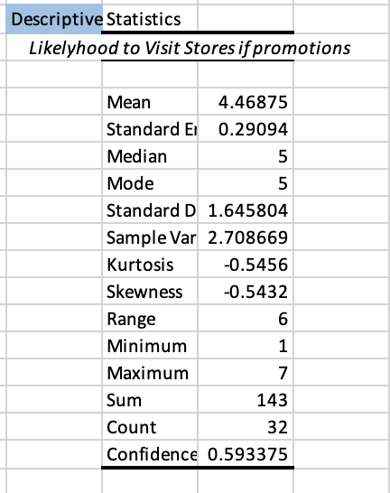
Description of Our Data: HT3

Slide 25
B. Hypothesis Test and Statistical Method
Hypothesis Test 3: Familiarity With the Promotion Program vs. Overall Rate on the Promotion Program
Ho:there is no relationship between familiarity of the program and likelihood people going to visit the store if Starbucks offer promotion
Ha:there is relationship between familiarity of the program and likelihood people going to visit the store if Starbucks offer promotion.
Statistical Method: Chi-Square
Categorical variables (we take each rating as a category)
Compare actual result with expected result
Relationship between two categorical variables

Slide 26
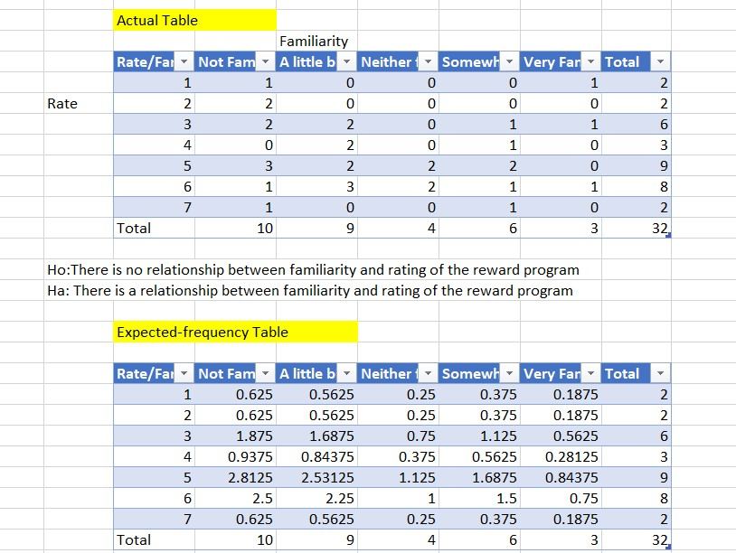
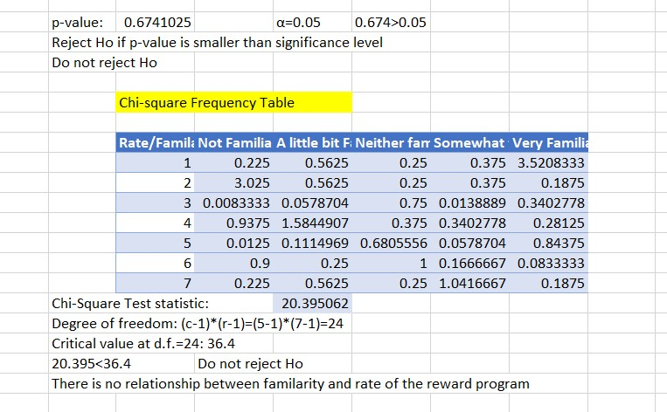
C. Results of Hypothesis Tests at Significance level =0.05
Hypothesis Test 3

Slide 27
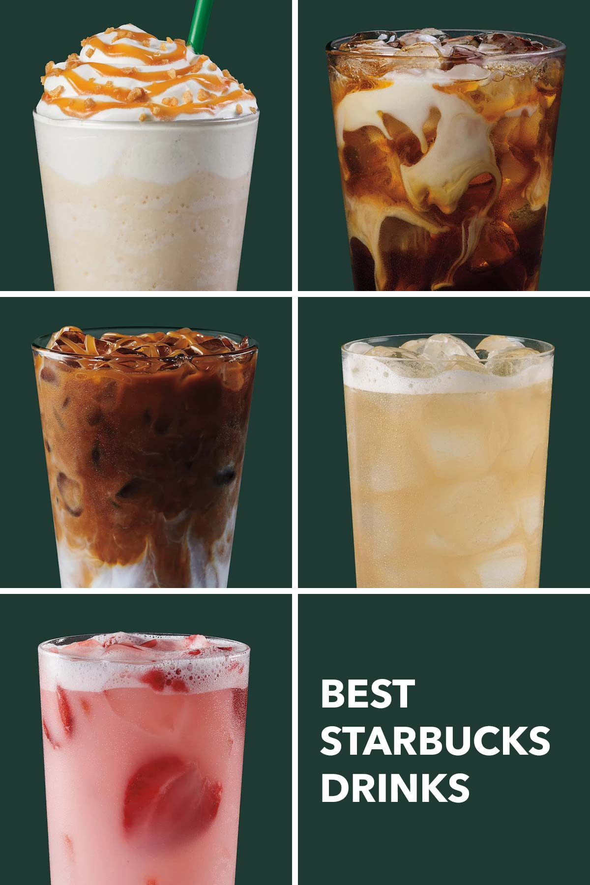
Part 6: Conclusions & Recommendations

Slide 28
Part 6: Hypothesis Test 1
A.Conclusions: There is no relationship between annual income and average price people pay per cup.
Additional information needed to gathered:
Spending habits of different groups
Collecting more samples
Studying consumer behavior in depth
Starbucks brand influence

Slide 29
Part 6: Hypothesis Test 1
B. Limitations of our research
Sampling Method: receiving incomplete questionnaires, self selection biased
Sampling Size: relatively small, less than 50
Sampling Error: potential calculation error and underlying error occurred during the process
Additional Research: conduct interviews with respondents from each demographic group on how fluctuation of their annual incomes affect their responses on average money spent per cup of coffee.

Slide 30
Part 6: Hypothesis Test 2
A.Conclusions: There is difference between consumers' satisfaction rate on affordability of coffee and their rate on promotion program
Additional information needed to gathered:
Context and Frame: asking what they are dissatisfied about the program
Interview with customers: what they would make a difference if they were asked to design the reward program?
Study the correlation in depth: what attract customers first? Reward Program? Or Starbucks products?
Focus group: conducts focus groups with reward program members and non-reward program customers to see what bring them to the store.

Slide 31
Part 6: Hypothesis Test 2
B. Limitations of our research
Sampling Method: receiving incomplete questionnaires, convenient sample off-targeted the population interest (some friends of ours are not familiar with Starbucks)
Sampling Size: relatively small, less than 50
Sampling Error: potential calculation error and underlying error occurred during the process
Additional Research: We need to use simple random sampling to make sure we target on the population of interest.

Slide 32
Part 6: Hypothesis Test 3
A.Conclusions: There is no relationship between familiarity and rating of the reward program
Additional information needed to gathered:
Relationships between familiarity/ rate: positive or negative
Collecting more samples (32)
Studying the overall attitude people have toward any promotion program: people will get annoyed if stores ask them to sign up for memberships.

Slide 33
Part 6: Hypothesis Test 3
B. Limitations of our research
Sampling Method: receiving incomplete questionnaires,people get bored with the questionnaire and they gave up on the last one (rate the reward program)
Sampling Size: relatively small, less than 50→ 32 sample
Sampling Error: potential calculation error and underlying error occurred during the process
Additional Research: conducting in-depth disguised personal observation on what makes customers more engaged when making a purchase: Discount? Free gift? Prospect theory on lost vs. gain?

Slide 34
Conclusion and Recommendations
Increased coffee prices negatively impact Starbucks' market competitiveness.
The proposed marketing strategy of offering more promotions/discounts could help address the problem.
Limitations include the small sample size of the survey and the potential impact of external factors such as inflation.
Recommendations:
Implement the proposed marketing strategy of offering more promotions/discounts to indirectly decrease coffee prices.
Consider partnering with local businesses to offer discounts and increase brand exposure.
Continue to monitor market trends and consumer preferences to adapt the marketing strategy as needed.
Explore potential solutions to address the underlying problem of unmet consumer needs, such as offering more affordable options for working or lower-class families.

Slide 35
Links of research articles
CBC News link: https://www.cbsnews.com/news/starbucks-prices-inflation/
Coffee Market share: https://www.mordorintelligence.com/industry-reports/coffee-market
Starbucks close stores in China: https://www.npr.org/2020/01/28/800636364/starbucks-closes-more-than-2-000-stores-in-china-amid-coronavirus-outbreak
Link of the survey: https://rutgers.ca1.qualtrics.com/jfe/form/SV_3ekoLDx5PSbJ4CG

